Slide 1
Face Detector (Phase 1 Coding)
Created By: Patrick Collins, Rachael Collins, & Pierce Roark

Slide 2
Face Detector
Why is this important/interesting?
Utilizing Github for Team Project
Remote Code Base for Team to Upload and Edit Code

Slide 3
Original Python Design
Chosen layout
Pygame for front end
Cross platform
The project entirety in one language
Built in gaming components

Slide 4
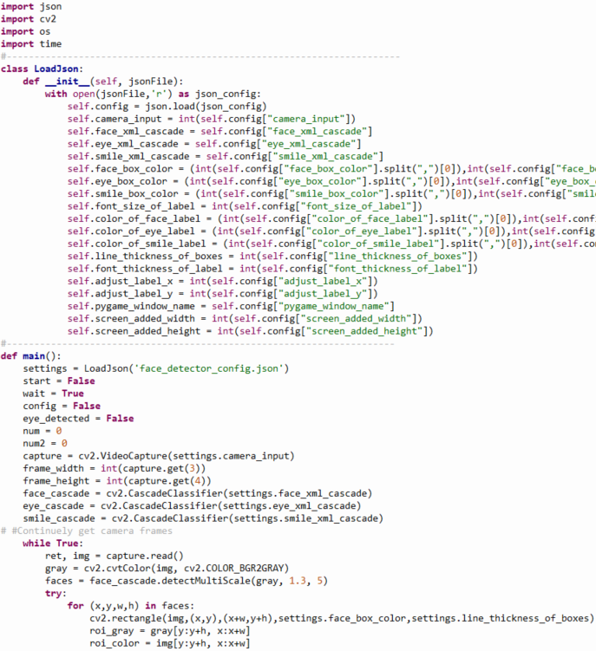
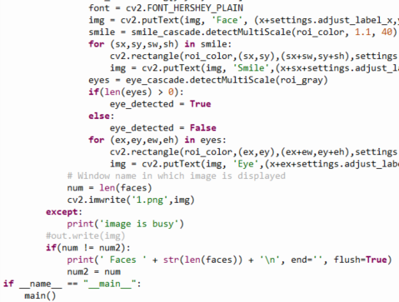
Python Code

Slide 5
Final Project Design (C# + Python)
Pygame GUI
Issues
Hard to create GUI components like buttons and input boxes
Time consuming to add new components
C# GUI
Solves
Pygame Issues
Easy use of json editing with input boxes
Issues
Picture Box Glitches

Slide 6
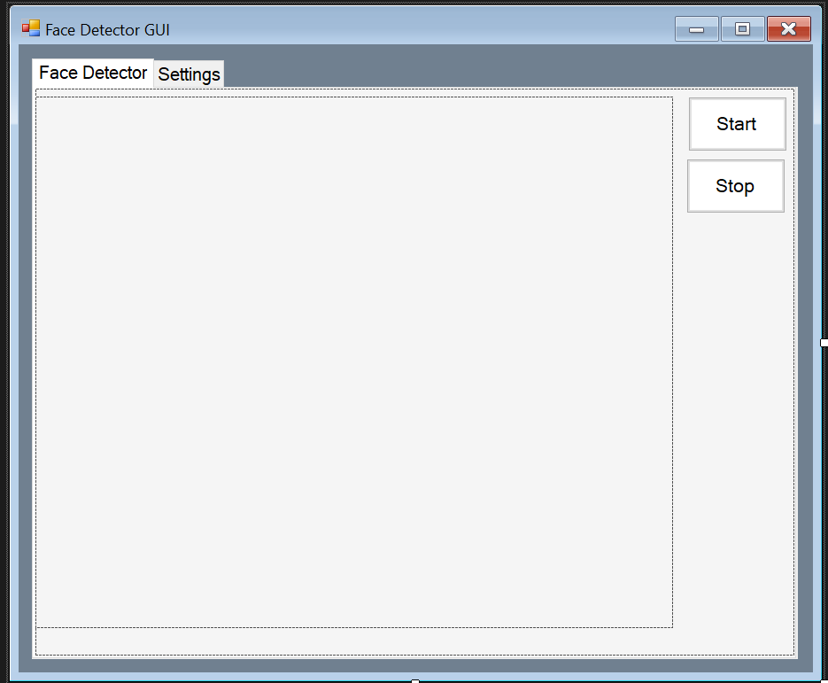
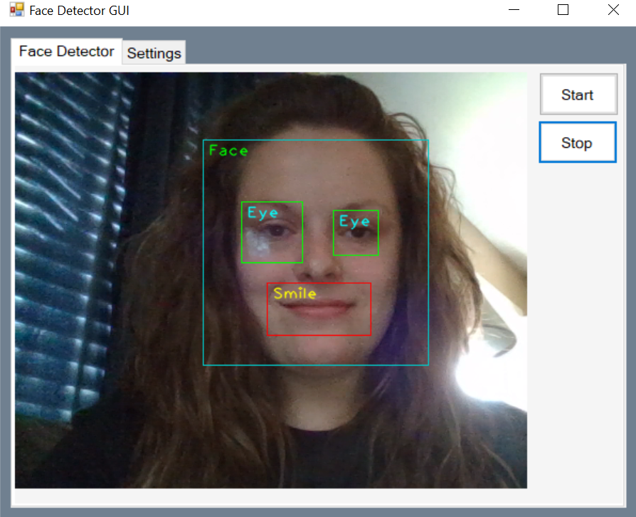
C# Windows Application that runs Python Program
Before starting application
After pressing start

Slide 7
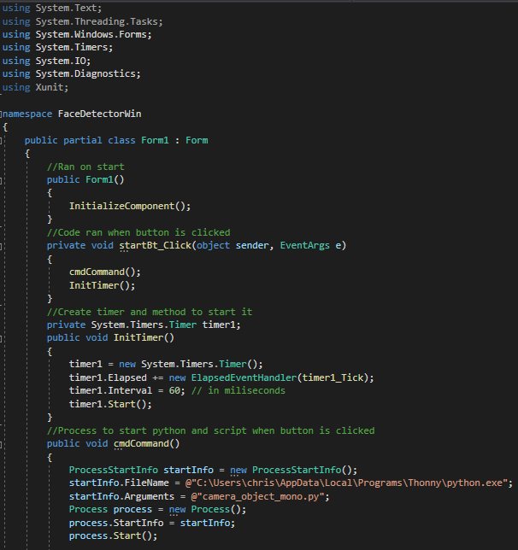
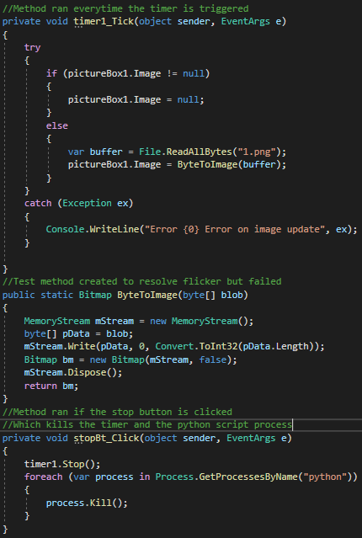
C# Windows Application Code

Slide 8
C# Windows Application Issues

Slide 9
Face Detection Game
Why add a game
What is it
Python
Pygame
Early Concept

Slide 10
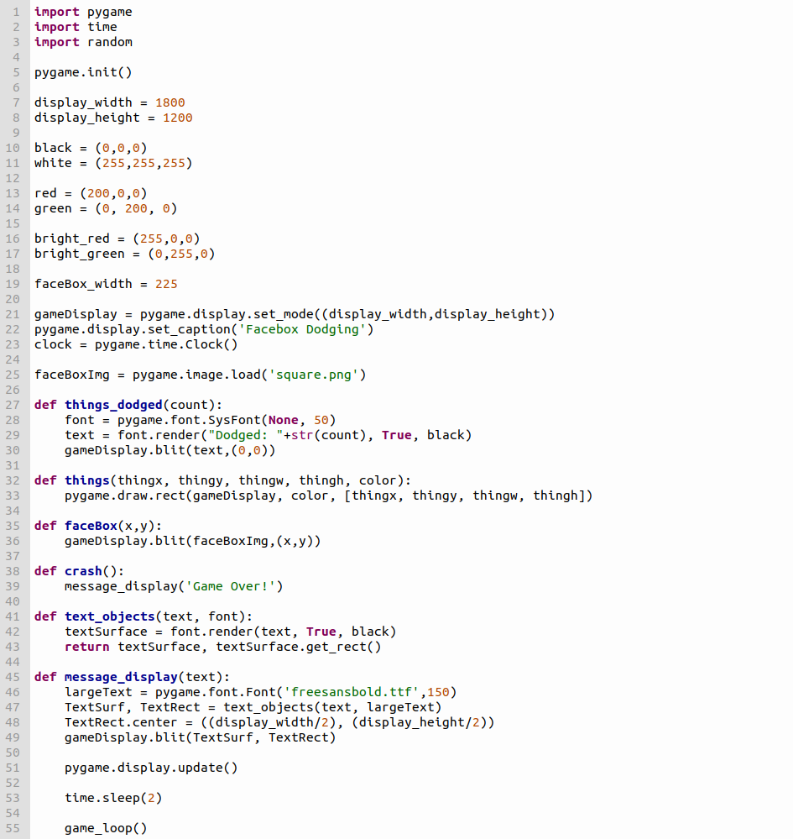
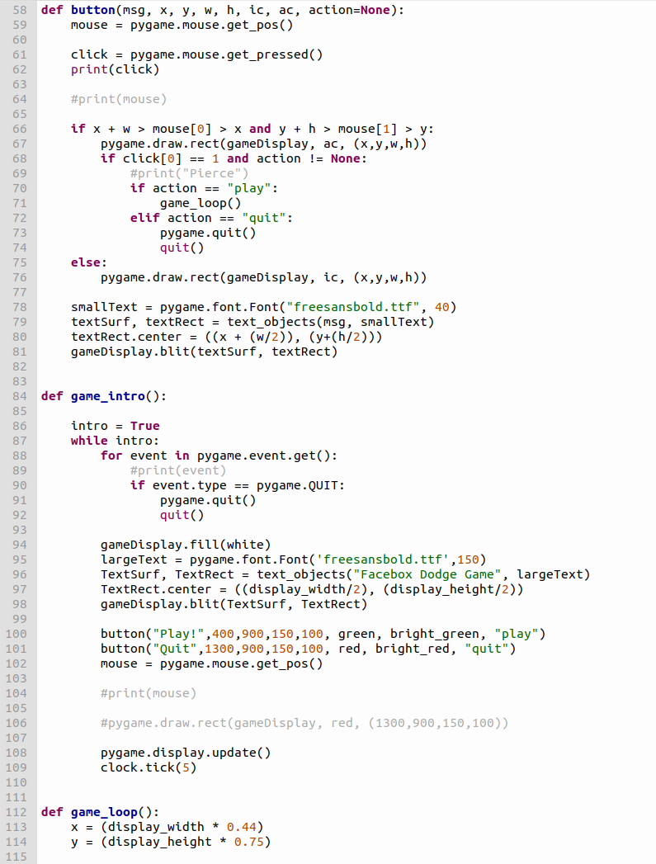
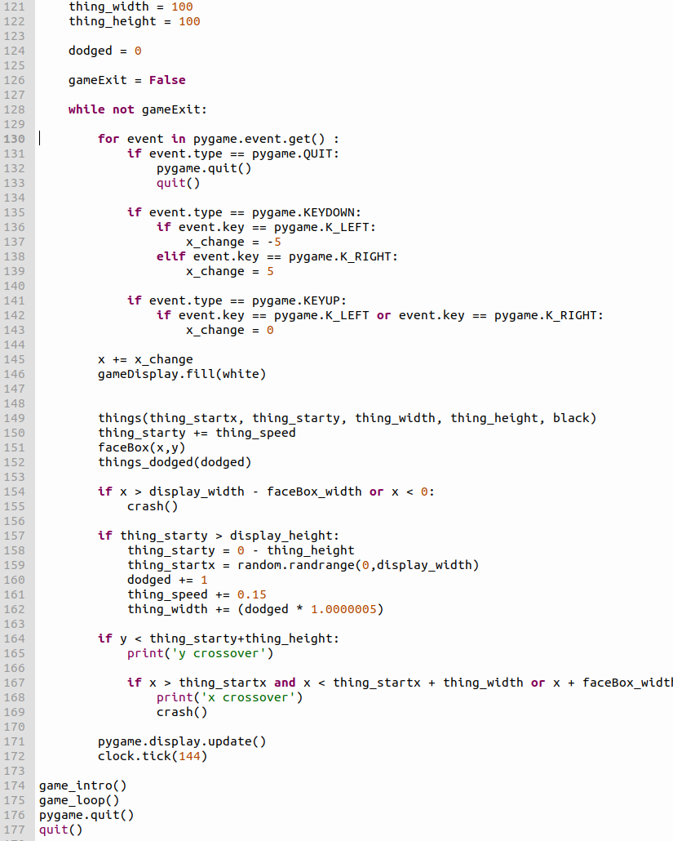
Phase 1 Game Code

Slide 11
Game Progress
Issues
Implementation
Face Box
Collision Detection
Using webcam video as background
Phase 2
Implemented to main
Difficulty
Save user scores
New game modes
Bug Fixes
Phase 1 Version

Slide 12
Team Plan for Phase 2 Implementation
Eliminate C# Application Glitches
Visual Enhancements
Additional Settings
Possible Gaming Features

